Slide 1










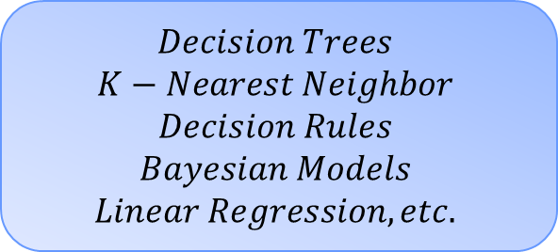

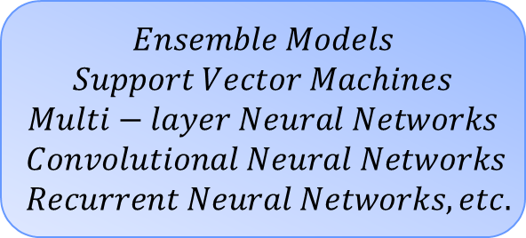





$$Opaque models$$
$$Transparent models$$
Derive explanations for
complex ML models
→ Model based ←
Build interpretable ML models
$$Ensemble Models$$
$$Support Vector Machines$$
$$Multi−layer Neural Networks$$
$$Convolutional Neural Networks$$
$$Recurrent Neural Networks, etc.$$
$$Decision Trees$$
$$K−Nearest Neighbor$$
$$Decision Rules$$
$$Bayesian Models$$
$$Linear Regression, etc.$$
$$Explainable$$
$$models$$
$$Post−hoc Explainability$$
$$Agnosticity$$
$$Scope$$
Model-agnostic
Applicable to
all model types
Global
explanation
Explaining the whole
model
Model-specific
Only applicable to a
specific model type
Local
explanation
Explaining individual predictions
$$Data Type$$
$$Explanation Type$$
$$Visual$$
$$Feature importance$$
Graph
Image
Data visualisation techniques may be used to understand the pre-diction or choice made over the input data.
After all possible combinations, we get the feature importance based on its average predicted marginal con-tribution to the model's decision.
Text
Tabular
$$Data points$$
$$Surrogate models$$
This category includes all methods that return data points (already ex-istent or newly created) to make a model interpretable.
We can explain our complex model’s prediction by using a simplified model (surrogate model) to appro-ximate it around the prediction.

